Slide 1
Final project 3400
Interamerican University of Puerto rico
Aguadilla campus
Raul X Gonzalez-Matias
Y00339371
Comp3400 Sec:202010.70855
Deadline: December 7th 2019
Professor. Edgardo vargas moya

Slide 2
Introduction
With the recent class and development of this project, it has been interesting to work with the whole software development phase that we have discussed in class. The Pothole Tracking and Repair system was a very intriguing due to the fact that it has a very specific process used to collect all of the data then place it in its storage database. Its something that can be used now a days in Puerto Rico. Although enforcing it through a law would be the first step in applying this kind of design in a municipality for testing purposes. In this scenario, the main data is collected for the citizen including their name, address and phone number. This is done through the main app or page once opened and registered using a User ID and Password. The citizen then fills out the cost of the damage, address where it happened, location of the pothole, size and estimated cost of damages. The system then stores the address in a small database where its then sorted and district determined. The system prioritizes the repair of the pothole due to its size then proceeds to assign an ID to the Pothole, repair crew and the number of people in that crew. The number of equipment needed to work on the repair is also determined due to the size and amount of work hours needed. This is then all stored in a Work Order database. Once this has all been processed a Damage File is created and displayed on the system so that the internal employees can have the exact repair cost. This is a fun and interested project that I may take as a challenge to develop and present it to our local county and see if they do like the idea.

Slide 3
Summary
I consider one of the most important parts of the project being the whole design phase. It was extremely interesting, and I was able to absorb most of my knowledge through the development of the ERD, DFD and Data Dictionary. It was fairly simple to develop the interface using Netbeans and Swing as its pretty much a drag and drop GUI project. At first designing this project looked challenging but as soon as I started, it all made sense. Here’s a few pictures of my diagrams.

Slide 4


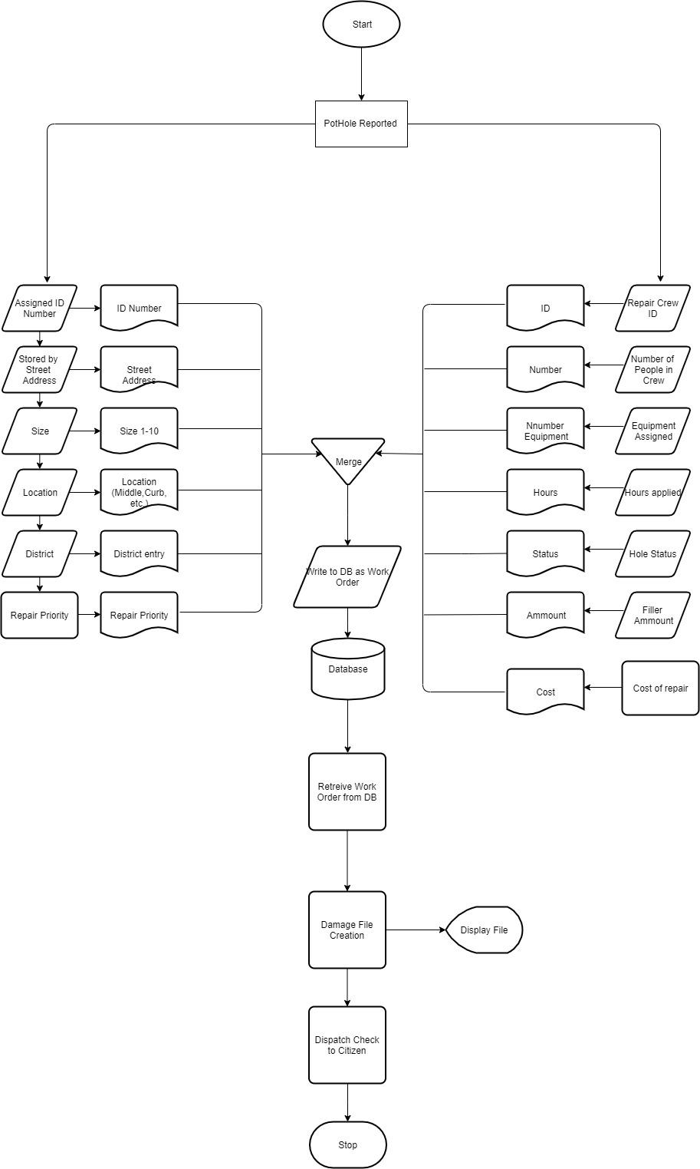
flowchart

Slide 5
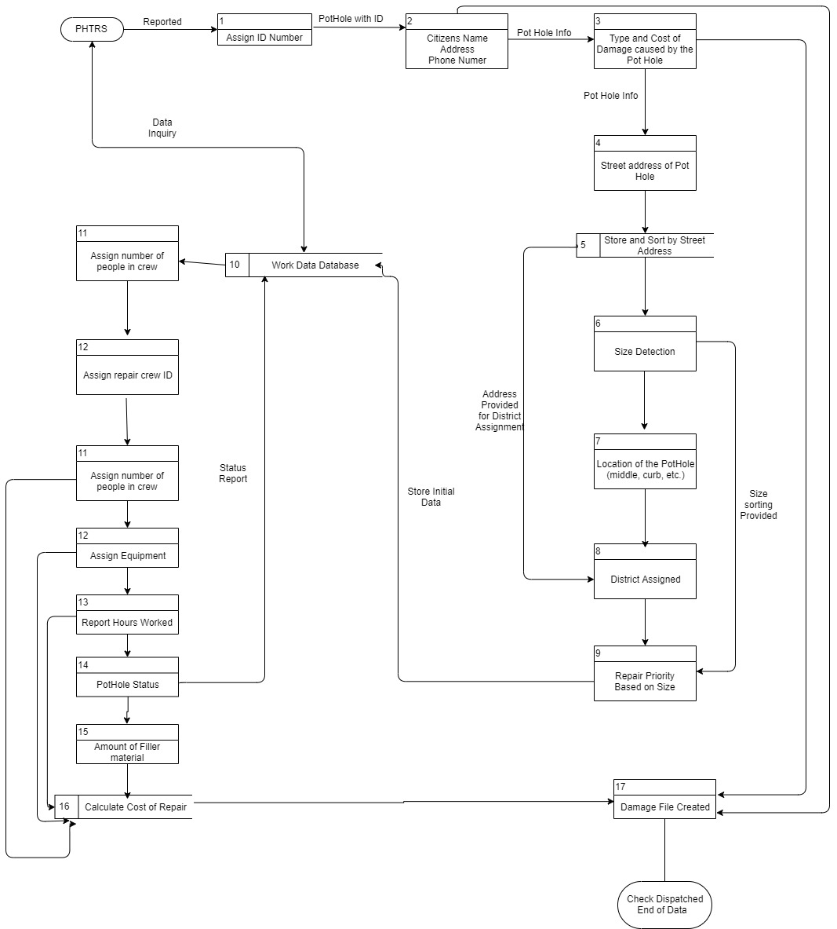
Data flow diagram

Slide 6
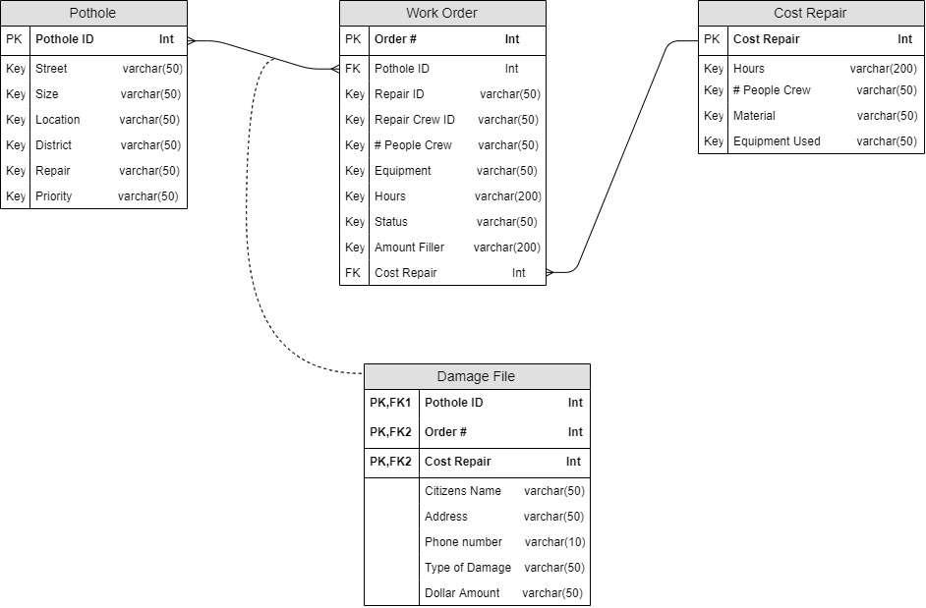
Entity relationship diagram

Slide 7
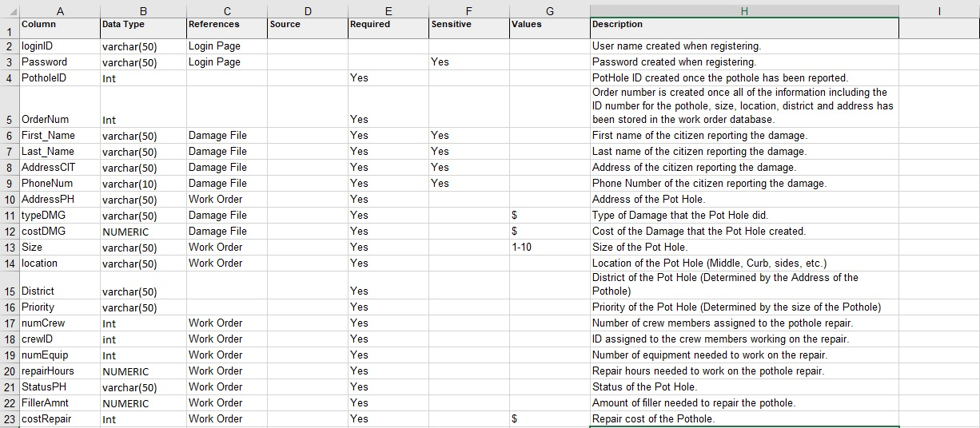
Data Dictionary

Slide 8
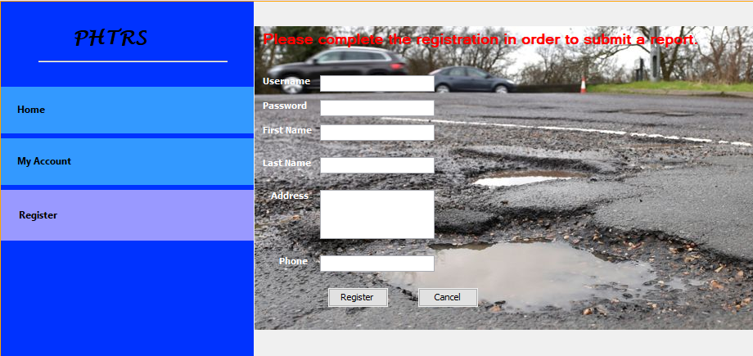
Interface

Slide 9
questions
For this kind of project, I would go with the Iterative development model, due to the fact that we wouldn’t need the full list of requirements before the project is started. We could always start with simple requirements to the now functional part which can be extended later on. It will also allow us to make new versions of the product which in this case is the PHTRS every cycle along the development. Each and every iteration will include the development of several components of this project and after that the component is added to the fully functional development at a later time.

Slide 10
Questions
One of the risks that I do see in this system is the sudden growth in requirements. Sure it may be able to handle a vast majority of entries within the Pothole database but if lets say, a county expands you’ll have more customers reporting in, or if the maintenance wasn’t done right you would have to include additional features in the software to ensure that all work is done properly. Productivity issues could be seen as another risk, due to the fact that a complex project like this can be challenging to some employees and as a result they end up losing significant time completing the project. There has to be a realistic schedule in order to fully complete this project. Finally, I believe that “Gold Plating” as it’s called, could cause another issue now a days where everything has to be “pretty” for the customer. Wasting time in unnecessary features, looks and all kinds of graphical animations may just take hours away from the initial project.

Slide 11
Questions
Personally, I would use Java to develop this project due to the fact that its been used for a long time now and its widely available to be used as a completed program on any kind of operating system. This does facilitate the development as it would also require a less complex structure of programming versus any of the older languages. There’s also a wide range of software developers that use Java which would also help driving costs down.

Slide 12
Questions
Software wise its always important to have the latest up to date software in order to prevent flaws that could interfere with the project or application that’s being developed. As a minimum requirement for the PHTRS, I would prefer that the client use Windows 8.1, Internet Explorer, and Java Version 8. Why Internet Explorer instead of Chrome or Firefox? Due to its RAM usage, Chrome’s security design and recent update has led to its increased usage of RAM which could be troublesome if the customer has limited amounts of. Windows 8.1 still receives security updates till this date so it would work as a minimum requirement. As for Java, version 8 should be the minimum which is currently the highest version. This is important due to security flaws that older Java runtime could have. Now for a Mac, if the application is Java based, the same Java version would apply. Safari as a minimum requirement for the browser as the same issues apply on the Mac side for those other browsers. With the application being developed in a 32bit environment (easier and more cost effective), Apple’s latest OS wouldn’t be supported as they’ve cut support on all 32bit applications. If the budget and team works fine, a 64bit alternative could be developed to run on both computers. With both using the same CPU architecture this shouldn’t be a challenge.

Slide 13
Questions
Hardware wise as opposed to software, is something that could be way more flexible since hardware now a days tend to stay valid and supported for years to come even though newer kind is released. As a minimum requirement of the developed application mentioned earlier, a PC with an Intel i3 based processor or newer would be recommended. RAM requirement could work with 4GB DDR3+ since Internet Explorer and Windows 8 are optimized. Hard Drive should have at least 20GB due to the main OS requirements. No dedicated GPU’s needed since the CPU processor will provide us with enough graphical power. If the application will also run on Mac’s, as a minimum requirement a Mac with a i3 Intel Processor or newer, no PowerPC support, RAM requirement would be the same as a PC, 4GB or more. Same with the HDD/SSD and GPU.

Slide 14
Questions
Project costs throughout the stages of development should stay at a reasonable level if I were the one managing and overseeing the development. Specially within the beginning stages of the project, there wouldn’t need to be a immense amount of funding towards the project as it would still be in development (development of the application in terms of a pure base line) Once the full project development has been completed and we see that the customer is satisfied with the final product, then it would be wise to invest more in the looks and feel of the product in order to complete a final and polished product. Sure, we could polish some steps when showing the process to the client that way they do get impressed with it, however this would consume additional resources and hours. For the requirement gathering and analysis there’s minimal cost if any or no cost at all as this is just the research and inquiry of the details of the project so this phase is pretty straight forward. The design is one of the other steps in the cycle where the costs start rising, with he design you do need a team that would be in charge of taking the information from the analysis done earlier and from the client and developing the mockup of the project. An estimated cost in this phase could be of about $800 US dollars. This was calculated using an estimated hourly cost of $100/hr for a basic developer as it could take about 8 hours to design. Once designed, the Coding is then started. Coding a project of this magnitude could cost (based on the hourly charged mentioned earlier) up to $10,000-$20,000 if we only hire one single software developer, consider the cost doubling or even tripling if we would decide to speed up the process so about $45,000. Testing can be done quick and effective. Id say about 8 hours so another $800 for a single developer. The deployment of the project has no cost as it would be the client and users using and testing the application. Maintenance can be done by just one software developer or the IT department of the client so cost would be minimum as well, maybe 5 hours a month. Driving the final costs of the whole project, on a estimate of $50,000.

Slide 15
Conclusion
I understand that my project should be selected as it was carefully analyzed and drawn out to be as easy as possible for a software development team to observe and attempt to design it. The concept used wasn’t that crowded and can be followed at any pace or SDLC models. The low requirements for the project also helps to name my work as the chosen one. I obtained a ton of experience working on this project, from creating the designs, to reading about other projects and software development. The work done on this project will help me in future jobs and future software developments. One of the reasons I decided to work on this by myself not only because I like to do my work in time and not depend on others but because I want to ensure I learn about the whole process regarding software engineering, development and all of the steps needed to design a project from the start. I believe I’m ready from now on to tackle on a project of this magnitude thanks to my Professor and class given, something that I found challenging but in reality, it was just a fear of starting to work on this. Once started I did not stop and was able to finish this within a weeks’ time. This does tell me that ill be able to work on developing or designing software in my future jobs if taken seriously.

